Slide 1
Satellite monitoring of Gabon's forests
Francis MANFOUMBI
AGEOS
francis.manfoumbi@ageos,ga/ manfoumbi6@gmail.com

Slide 2
Outline
Background
Methodology (Data & Methods),Implementation
Activity, Product and Services
Results of the 2020 Land cover Mapping
Monitoring activities
Sub-regional roll-out

Slide 3
Introduction/Background
Gabonese Agency for Space Studies and Observations (AGEOS)
AGEOS is a Public establishment of a scientific nature, Created in 2010;
The mission
Contribute to the implementation of the Government's policy on the collection, analysis and availability of data from spatial observation of the national territory for the sustainable management of the environment, natural resources, land use, regional planning, and research and innovation »
Specifics missions:
Develop a national strategy for space observation activities;
Establish a space infrastructure;
Ensure the monitoring and evaluation of the implementation of public policies (roads, housing, energy, natural resources, etc.);
Provide data related to climate change;
Promote training, research and development activities.

Slide 4
At AGEOS we have:
Direct reception station;
A competence centre for satellite data processing.
Antennas
X-band antenna for optical or radar data, with a coverage radius of 2800 km, covering 24 countries;
S-band antenna for telemetry used to support spacecraft launchers;
Antenna exclusively reserved for the acquisition of meteorological data;
GMES&Africa antenna.
The decree 0074 of the Prime Minister, which sets out the modalities for monitoring activities that have an impact on the forest;
Creation of the forestry department within the Gabonese Agency for Space Studies and Observations (AGEOS).

Slide 5
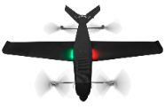
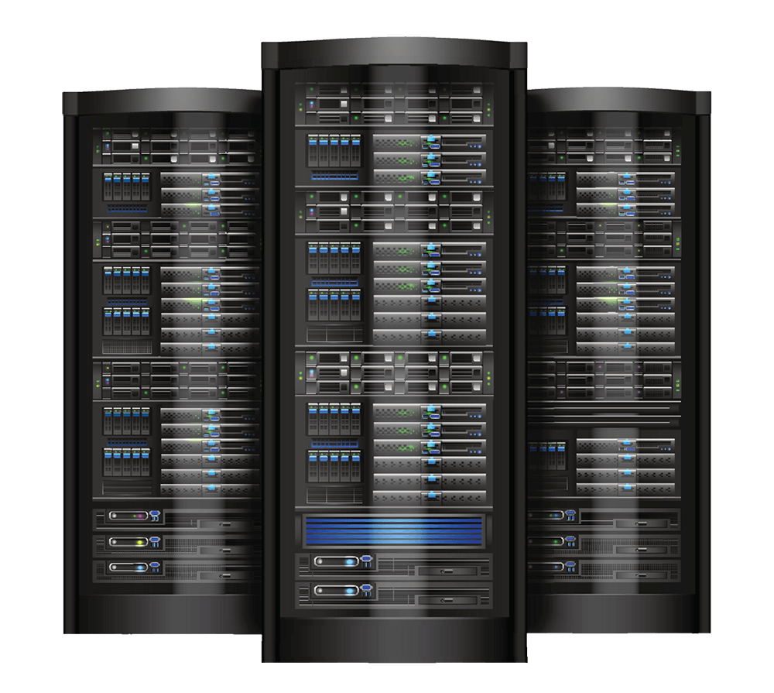
Methodology (Data & Methods), Implementation Plan/Activities
National Forest and Natural Ressources Monitoring System
Monitor the evolution of the national forest cover and land cover(surface estimation, stratification, biomasse, carbone) ;
Detect forest cover disturbances ;
Analyze the legal framework for the disturbances observed ;
Inform the actors in charge of forest control and police;
Analyze and characterize the activities impacting the forest cover;
Support for Capacity building of sectorial administrations in using earth observation tools for forest monitoring.
Geoportal
Satellite data
Field campaigns
Decision makers
Data Sharing tools
Automatic System Processing and Detection
Output report
Analysing
Partner network

Slide 6
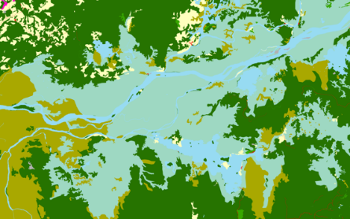
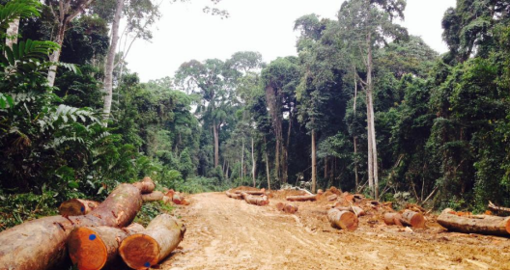
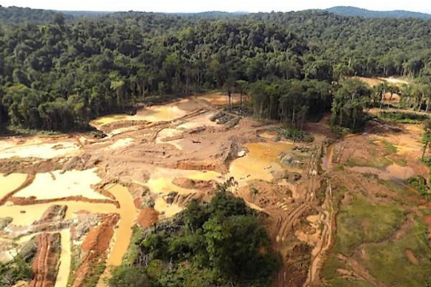
Activity, Product and Services
ACTIVITES, PRODUITS ET SERVICES
Land Cover
Logging Monitoring
Monitoring of Sensitives Sites
Carbon and Biomass
Annual mapping and quinquennial
State of land cover;
Change land cover;
State of forest (gain and loss).
Monitoring of activities operating
Monitoring bulletin;
Baseline of concessions; Estimation of exploited areas;
Conformity exploitation..
Near real-time monitoring
Warning deforestation.
Biomass Estimation and Carbon Mapping
Forest biomass mapping;
CVH mapping;
Forest Carbon Estimation.

Slide 7
Land cover mapping 2020 and changes between 2015 and 2020

Slide 8
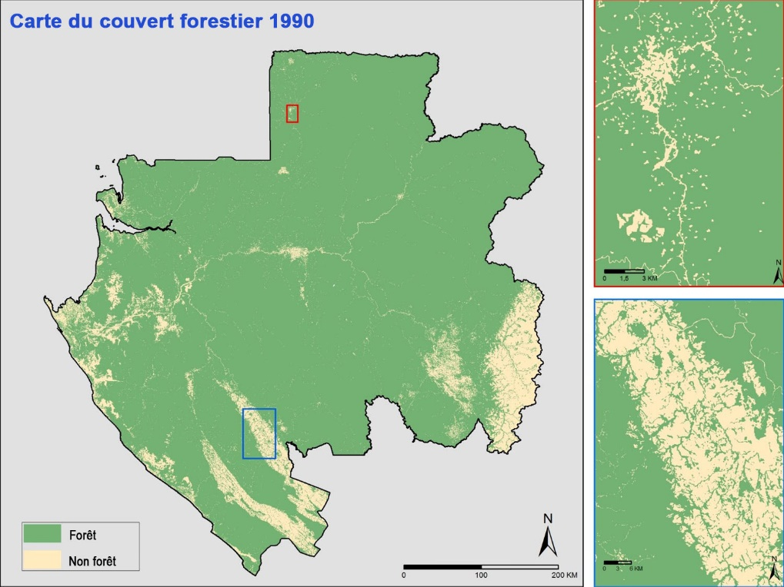
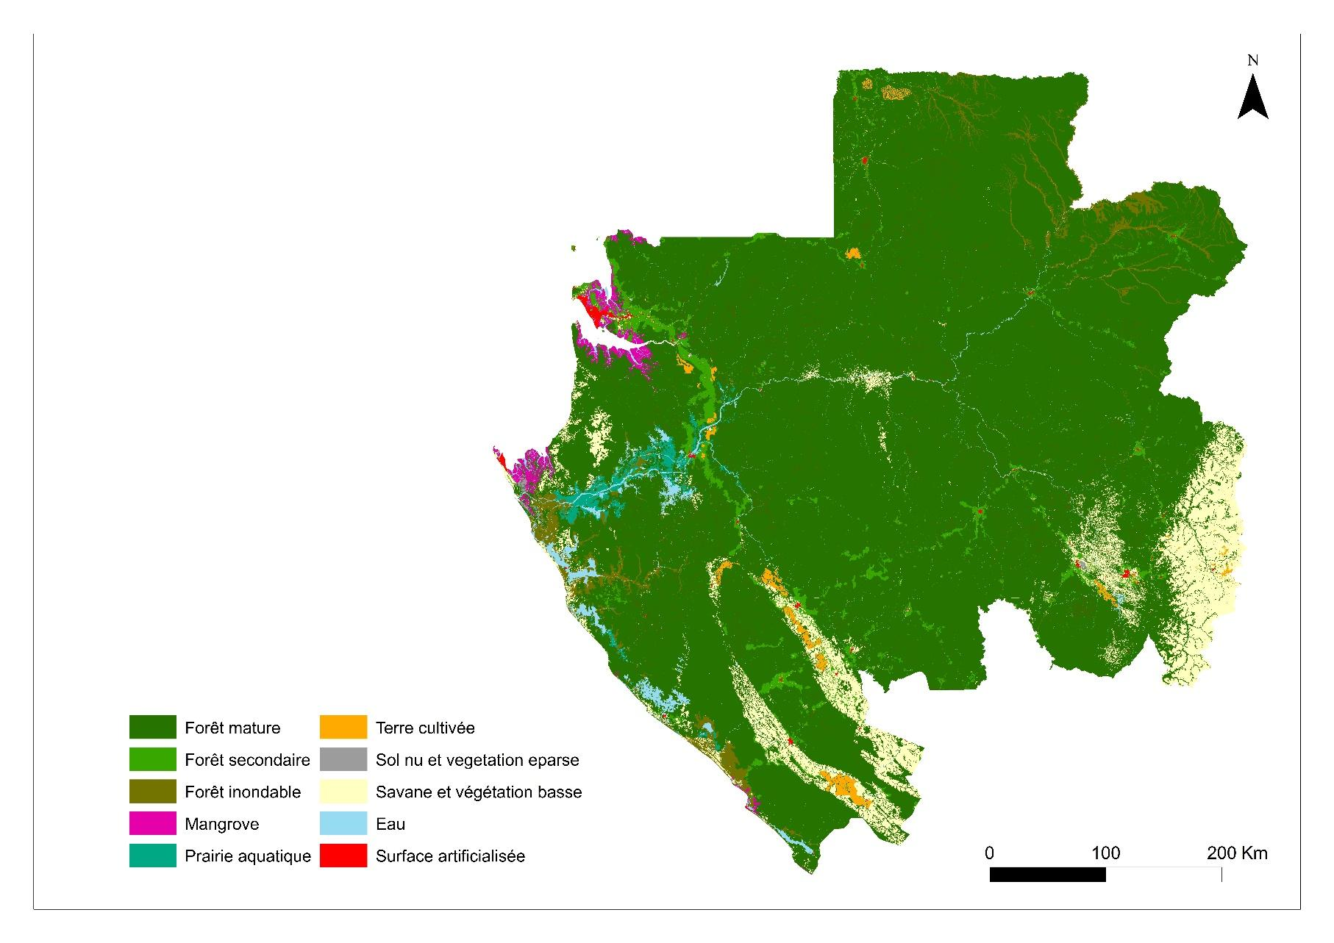
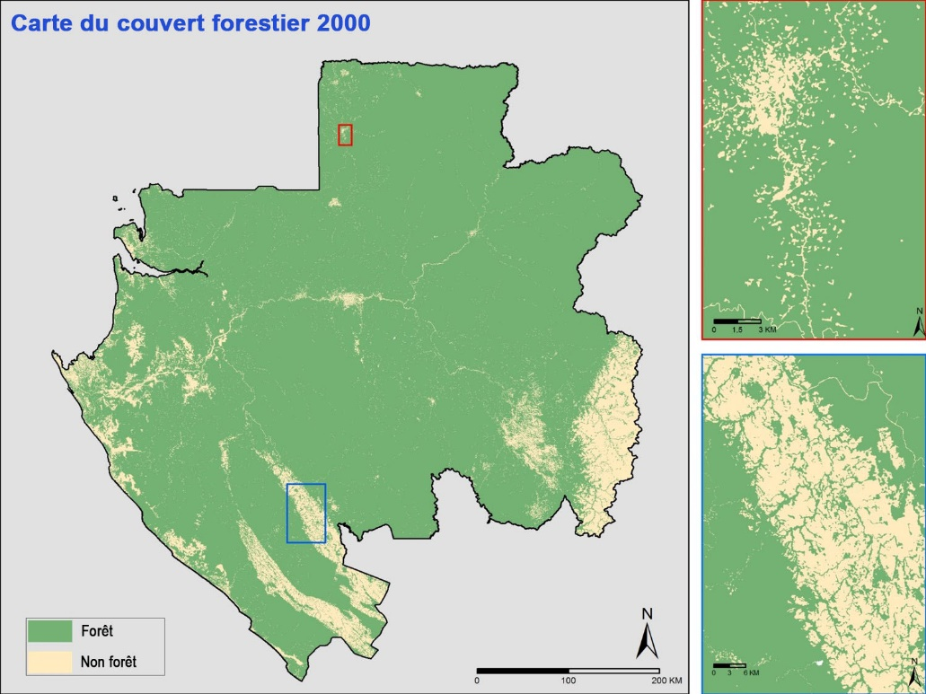
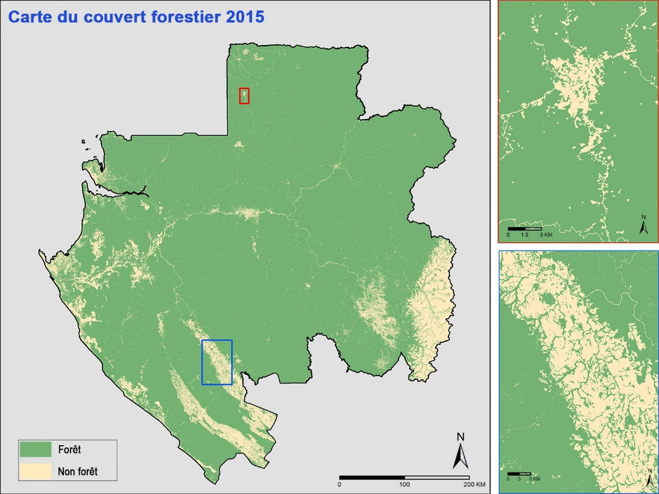
Results/Outputs
FOREST COVER AND LAND COVER MAPPING
2020

Slide 9
Results/Outputs
The state of land use in 2020
Land use class | Area ha
Mature forest | 21 826 164,32
Secondary drill | 919 611,01
Flooded forest | 614 985,56
Mangrove | 190 639,49
Cultivated land | 175 276,36
Bare soil | 44 468,09
Water meadow | 204 968,76
Savanna and low vegetation | 1 946 682,99
Water | 387 397,19
Settlements | 174 477,20

Slide 10
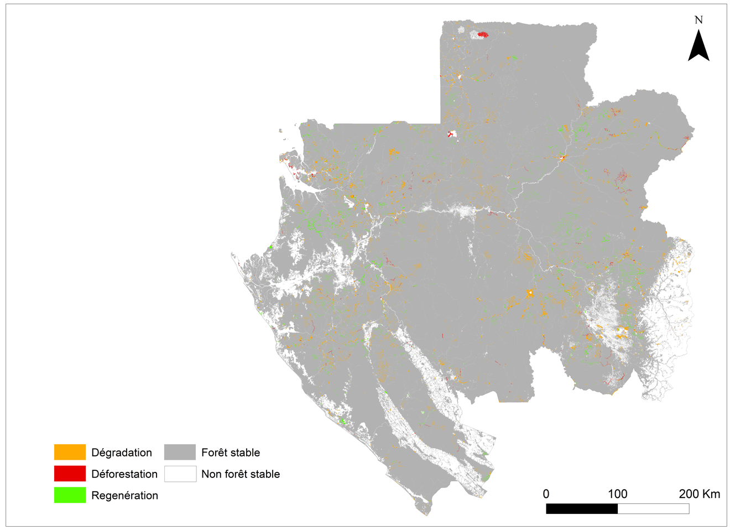
Results/Outputs
Land cover change map 2015-2020
 | ha | %
Deforestation | 10 885,16 | 20,25
Degradation | 42 873,08 | 79,75
Total | 53 758,24 | 100

Slide 11
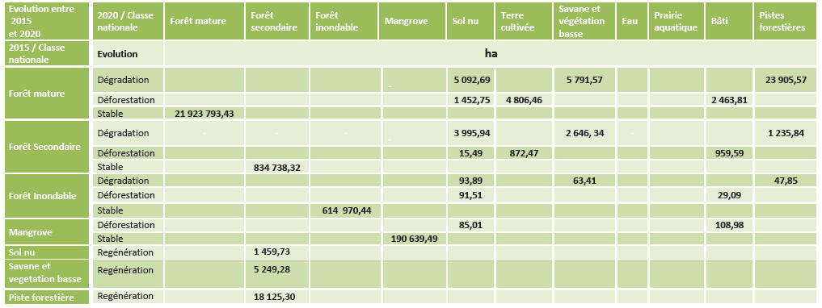
Changes in forests between 2015 and 2020

Slide 12
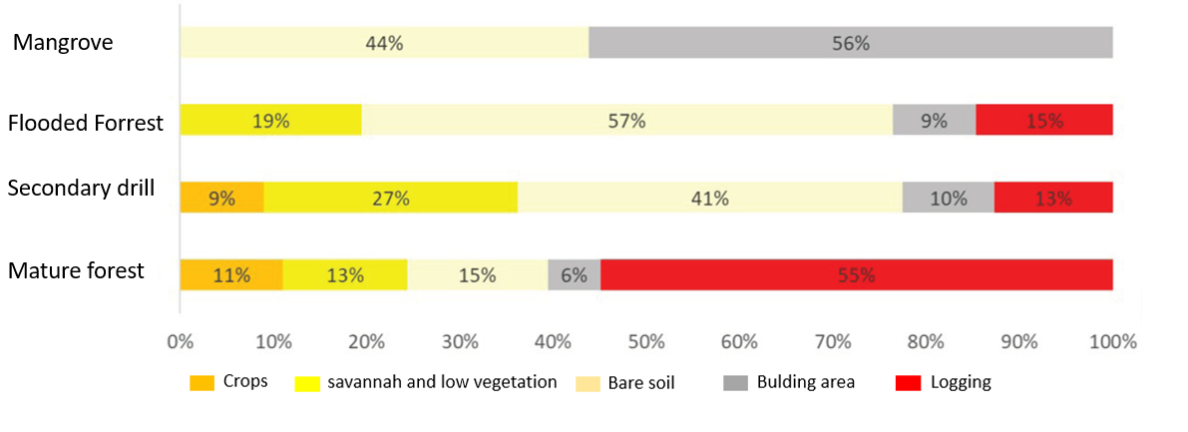
Results/Outputs
Conversion of forests by land use class

Slide 13
Monitoring activities
REGULAR MONITORING OF ACTIVITIES THAT IMPACT THE FOREST COVER

Slide 14
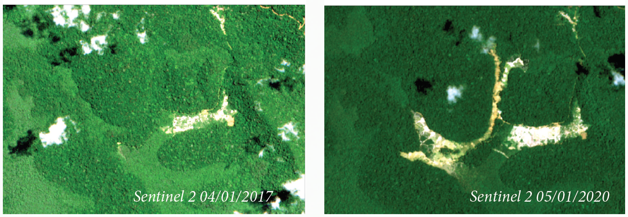
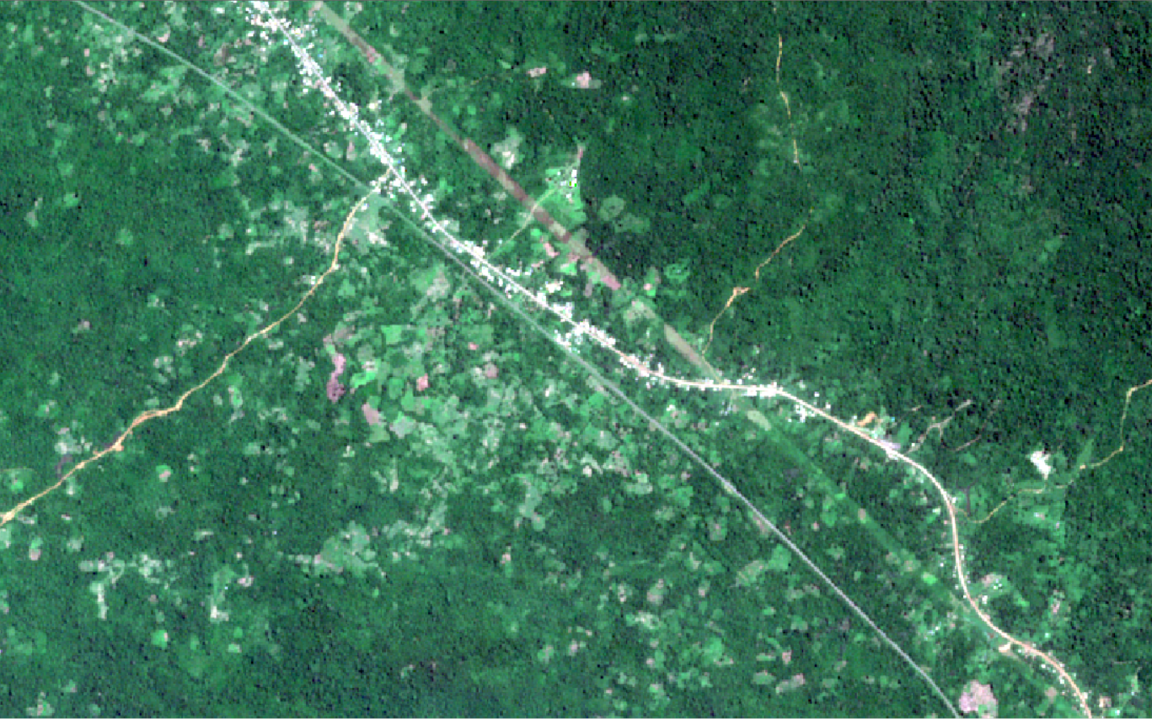
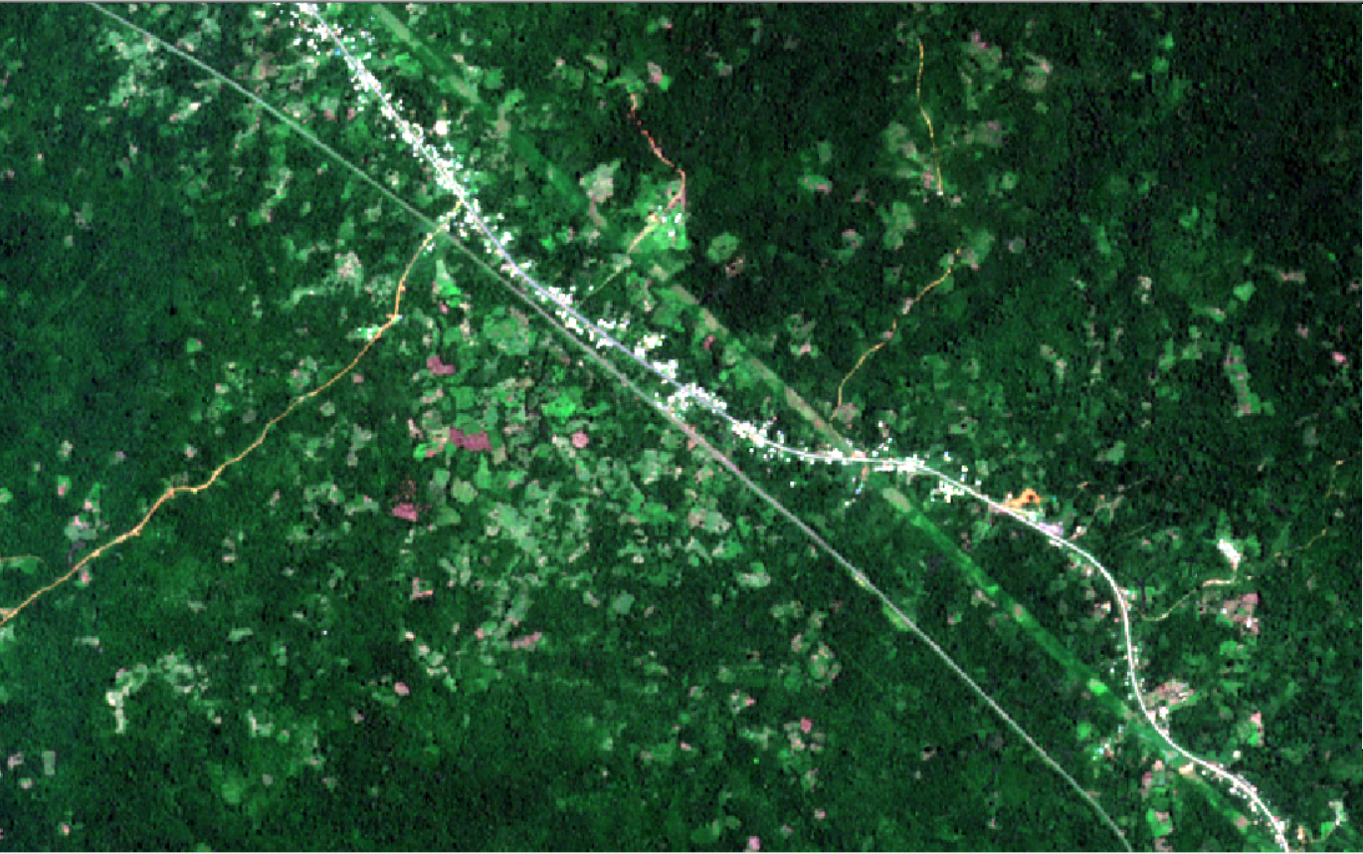
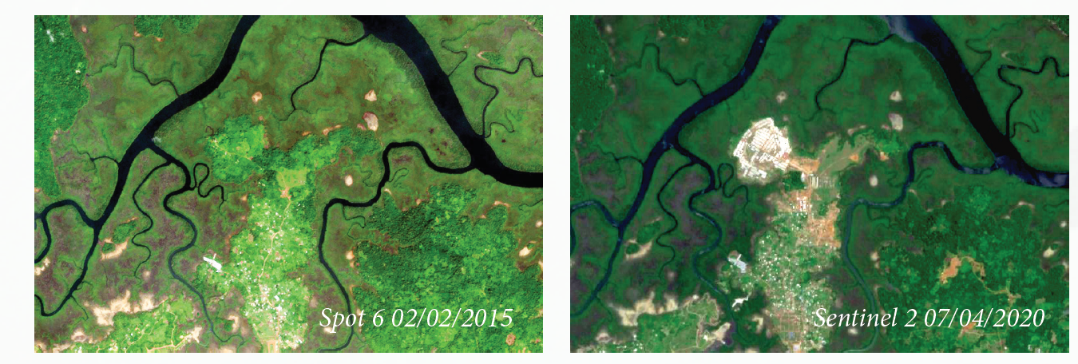
Agro-industry
Logging
Mining
Low soil cover, bare soil, shifting cultivation
Urbanization

Slide 15
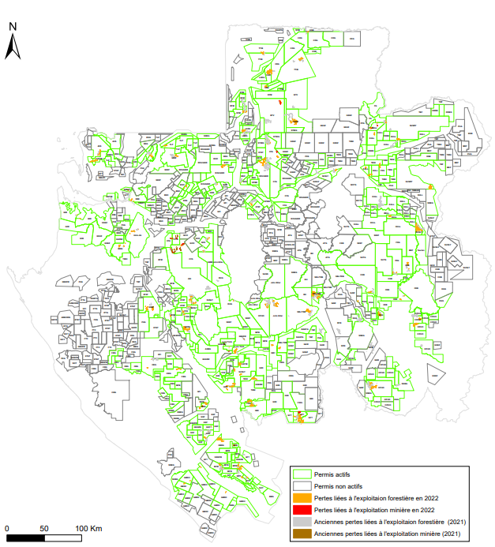
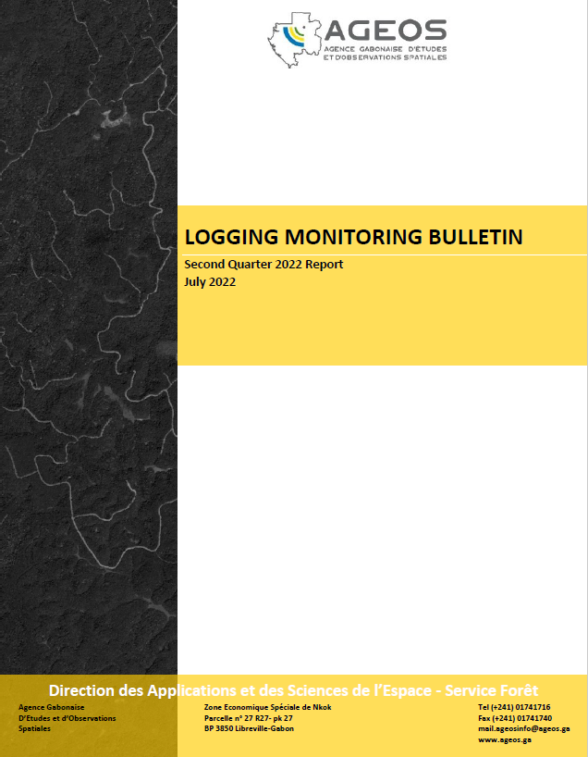
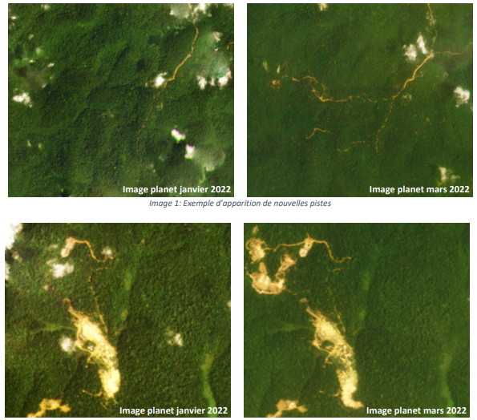
Logging Monitoring
The analysis of satellite images has revealed new activities.
In second quarter, 2615.93 ha of forest loss
56 active logging concessions;
425 permits out of 826, nearly 51.45%, are considered active.

Slide 16
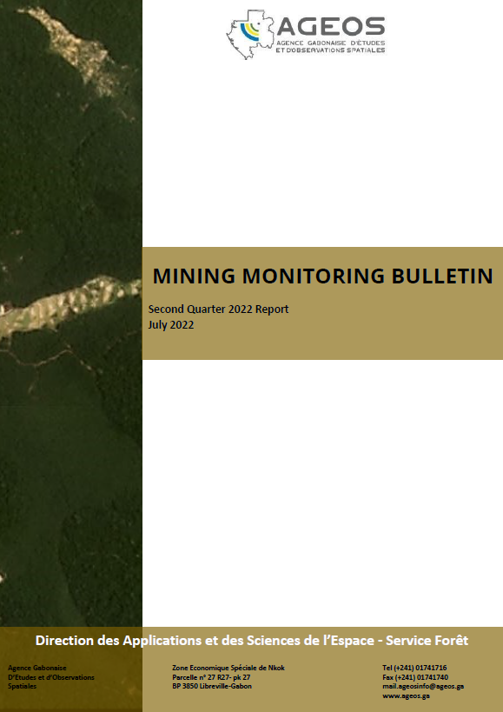
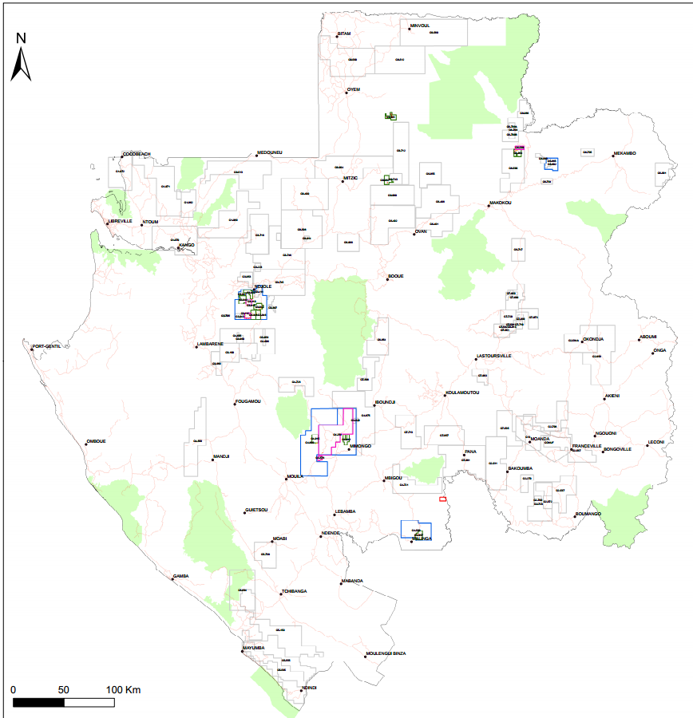
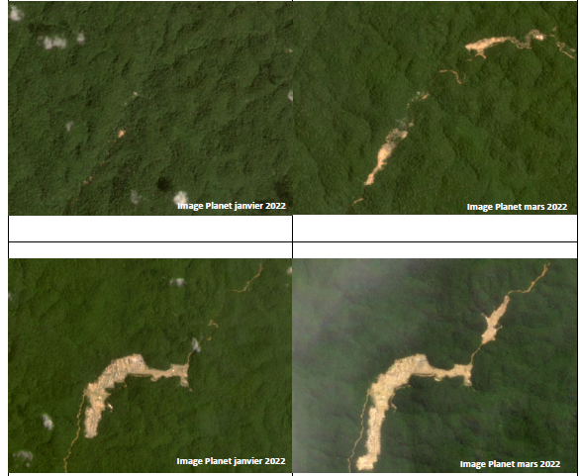
Mining Monitoring
The analysis of satellite images from the second quarter of 2022 has enabled the mapping of forest losses related to mining, across all mining permits in Gabon. Over this period, 401.32 ha of forest loss were detected.

Slide 17
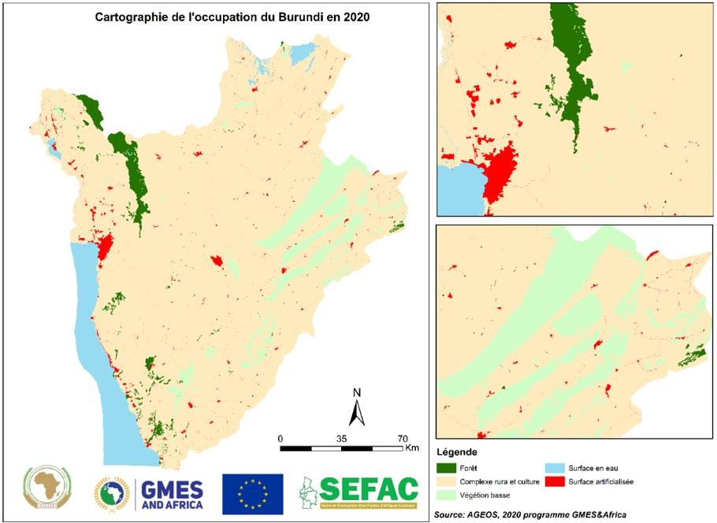
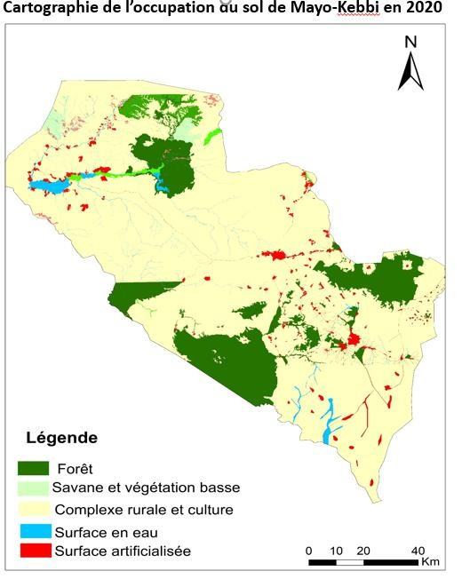
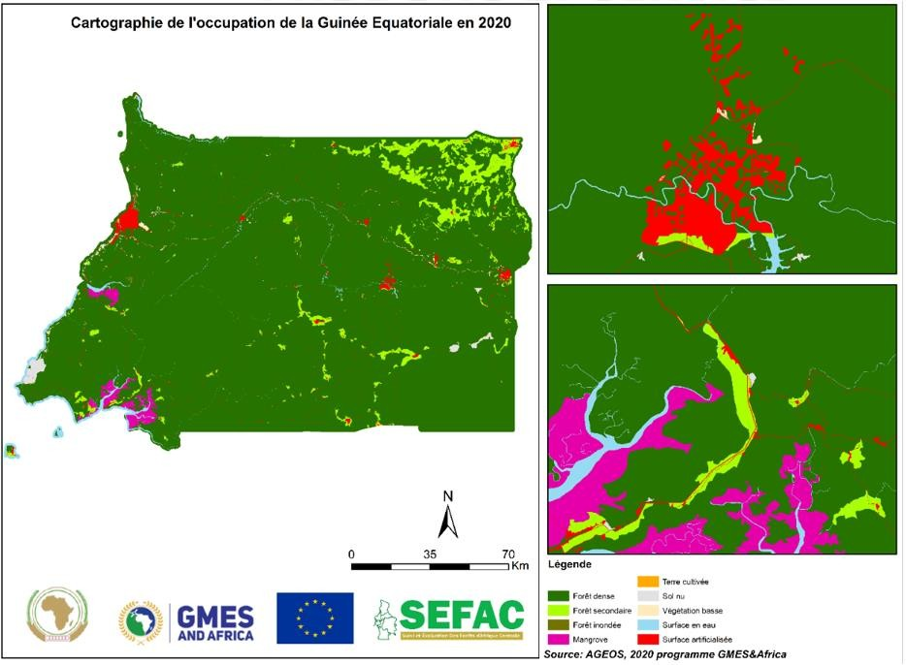
Sub-regional deployment:
The GMES&Africa project
Land cover map;
Detection of forest changes in near real time;

Slide 18
Collaborators, Stakeholders and Users
International
National

Slide 19
Thank you
Questions?

